Slide 1
Discrete Mathematics
Dr. Han Huang
South China University of Technology
1

Slide 2
Chapter 5. Trees
Introduction to Trees
Section 5.1
2

Slide 3
Contents
1
Definition of Trees
2
Trees as Models
3
Properties of Trees
3

Slide 4
Definition of Trees
4

Slide 5
Example 1
游戏中怪物的AI思考流程很相似，只有释放的技能不同的差别。其行为设计可以用树结构表示。

Slide 6
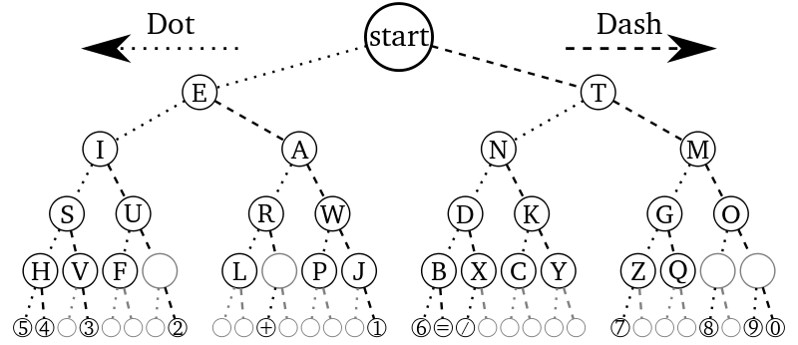
Example 2
摩斯密码

Slide 7
Example 3
假设一个袋子里有3个黑球和5个白球，从中有放回地任意取两次球。可以通过树结构构造该事件的概率。

Slide 8
Trees
Tree were used as long ago as 1857 by English mathematician Arthur Cayley used them to count certain types of chemical compounds.
Trees are particularly useful in computer science, where they are employed in a wide range of algorithms.

Slide 9
Trees
数据结构中树的定义：
树是由n(n≥0)个有限节点组成一个具有层次关系的集合，每个节点有零个或多个子节点，树结构通常用于表示层次关系。
离散数学中树的定义：
连通且不含回路的无向图。树可以看作是一种图的特殊情况，其中没有环。

Slide 10
Definition 1
A tree is a connected undirected graph with no simple circuits.
Example 1 Which of the graph are trees?
a
b
a
b
d
d
c
c
e
f
e
f
G1
G2

Slide 11
a
b
a
b
d
c
d
c
e
f
e
f
G3
G4
Circuits
Unconnected

Slide 12
Forest
Any graph (not necessary connected) that contains no simple circuits is called a forest.
a
b
c
d
e
f
G4

Slide 13
Tree and Forest Examples
A Tree:
A Forest:
Leaves in green, internal nodes in red.

Slide 14
Theorem 1: An undirected graph is a tree if and only if there is a unique simple path between any two of its vertices.
Proof :
(1) Assume that T is a tree. Then, T is connected with no simple circuits.
Let x and y be two vertices of T.
Since T is connected, there is a simple path between x and y.

Slide 15
Proof of Theorem
Moreover, this path must be unique, for if there were a second such path, the path formed by combining the first path from x to y followed by the path from y to x obtained by reversing the order of the second path from x to y would form a circuit.
This implies, that there is a simple circuit in T. Hence, there is a unique simple path between any two vertices of a tree.

Slide 16
Proof of Theorem
(2)Now assume that there is a unique simple path between any two vertices of a graph T. Then T is connected, since there is a path between any two of its vertices.
Furthermore, T can have no simple circuits.
To see that this is true, suppose T had a simple circuit that contained the vertices x and y.
Then there would be two simple paths between x and y, since the simple circuit is made up of a simple path from x to y and a second simple path from y to x. The proof is finished.

Slide 17
Rooted Tree
Definition 1: A rooted tree is a tree in which one vertex has been designed as the root and every edge is directed away from the root.
Rooted trees can also be defined recursively. We can change an unrooted tree into rooted tree by choosing any vertex as the root. Note that different choices of the root produce different rooted trees.

Slide 18
Rooted Tree Examples
Note that a given unrooted tree with n nodes yields n different rooted trees.
Same tree except for choice of root
root
root

Slide 19
Rooted-Tree Terminology Exercise
Find the parent, children, siblings, ancestors, & descendants of node f.
o
n
h
r
d
m
b
root
a
c
g
e
i
q
f
p
j
k
l

Slide 20
Example
In the rooted tree T (with root a), find the parent of c, the children of g, the sibling of h, all ancestors of e, all descendants of b, all internal vertices, and all leaves.
What is the subtree rooted at g?
a
g
b
f
g
h
i
j
c
h
i
j
k
l
m
d
e
k
l
m

Slide 21
n-ary trees
A rooted tree is called n-ary if every vertex has no more than n children.
It is called full if every internal (non-leaf) vertex has exactly n children.
A 2-ary tree is called a binary tree.
These are handy for describing sequences of yes-no decisions.
Example: Comparisons in binary search algorithm.

Slide 22
Example
Are the rooted trees full m-ary trees for some positive integer m ?
T1 is a full binary tree since each of its internal vertices has two children.

Slide 23
Example
T2 is a full 3-ary tree since each of its internal vertices have three children.

Slide 24
Example
In T3 each internal vertex has five children, so T3 is a full 5-ary tree.

Slide 25
T4 is not a full m-ary tree for any m since some of its internal vertices have two children and others have three children.

Slide 26
Ordered Rooted Tree
This is just a rooted tree in which the children of each internal node are ordered.
In ordered binary trees, we can define:
left child, right child
left subtree, right subtree
For n-ary trees with n>2, can use terms like “leftmost”, “rightmost,” etc.

Slide 27
a
h
i
b
c
l
d
e
h
i
j
k
l
m
f
g
j
k
m
The left child of d is f and the right child is g. We show the left and right subtree of c.

Slide 28
Trees as Models
28

Slide 29
Trees as Models
Can use trees to model the following:
Saturated hydrocarbons
Organizational structures
Computer file systems
In each case, would you use a rooted or a non-rooted tree?

Slide 30
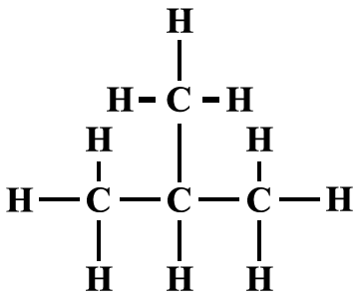
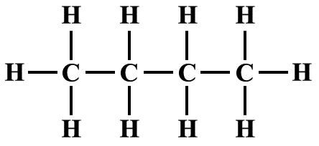
Example 1 : Saturated hydrocarbons
Graphs can be used to represent molecules, where atoms are represented by vertices and bonds between them by edges.
正丁烷
异丁烷

Slide 31
Example 2: Representing Organization
The structure of a large organization can be modeled using a rooted tree. Each vertex in this tree represents a position in the organization.
An edge from one vertex to another indicates that the person represented by the initial vertex is the direct boss of the person represented by the terminal vertex.

Slide 32
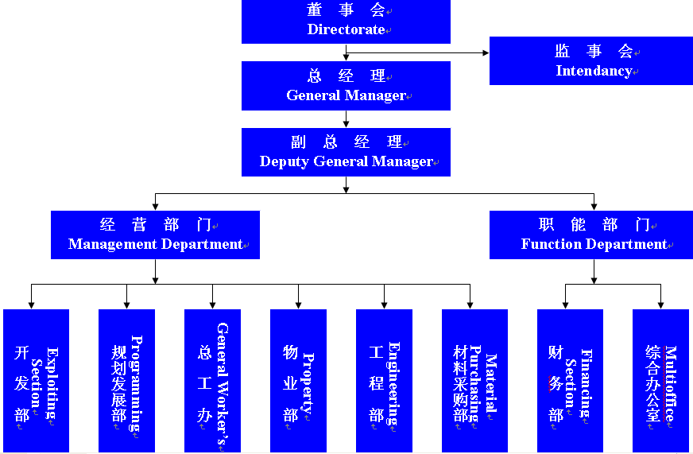
Example 2: Representing Organization

Slide 33
Example 3: Computer File System
Files in computer memory can be organized into directories.
A directory can contain both files and subdirectories.
The root directory contains the entire file system.
A file system may be represented by a rooted tree, where the root represents the root directory, leaves represent ordinary files or empty directories.

Slide 34
Example 3: Computer File System
Linux文件系统中的主要目录文件包括：/bin里存放了标准的linux工具，比如“ls”和“vi”等。/usr里包含了许多子目录，/usr/bin目录用于存放程序；/usr/share用于存放共享的数据；/usr/lib目录用于存放程序运行所必须的一些库文件。/tmp则一般为用户或正在执行的程序临时存放文件的目录。

Slide 35
Properties of Trees
35

Slide 36
Theorem 2: A tree with n vertices has n-1 edges.
Proof: We will use mathematical induction. Note that for all the trees here we can choose a root and consider the tree rooted.
(1) When n=1, a tree with n=1 vertex has no edges. It follows that the it is true for n=1.
(2) The induction hypothesis states that every tree with k vertices has k-1 edges, where k is a positive integer.

Slide 37
Suppose that a tree T has k+1 vertices and that v is a leaf of T, and let w be the parent of v.
Removing from T the vertex v and edge connecting w to v produces a tree T’ with k vertices, since the resulting graph is still connected and has no simple circuits.
By the induction hypothesis, T’ has k-1 edges.
It follows that T has k edges since it has one more edge than T’, the edge connecting v and w.

Slide 38
Theorem 3: A full m-ary tree with i internal vertices contains n=m*i+1 vertices.
Proof: Every vertex, except the root, is the child of an internal vertices has m children, there are m*I vertices in the tree other than the root.
Therefore, the tree contains n=m*i+1 vertices.

Slide 39
Theorem 4: A full m-ary tree with
(i) n vertices has i=(n-1)/m internal vertices and l=[(m-1)*n+1]/m leaves,
(ii) i internal vertices has n=m*i+1 vertices and l=(m-1)*i+1 leaves,
(iii) l leaves has n=(m*l-1)/(m-1) vertices and i=(l-1)/(m-1) internal vertices.

Slide 40
Theorem 4: A full m-ary tree with
(i) n vertices has i=(n-1)/m internal vertices and l=[(m-1)*n+1]/m leaves,
Proof: Let n represent the number of vertices, I the number of internal vertices, and l the number of leaves.
Solving for i in n=m*i+1 gives i=(n-1)/m.
Then inserting this expression for i into the equation n=l+i shows that
l=n-i=n-(n-1)/m=[(m-1)*n+1]/m.

Slide 41
Theorem 4: A full m-ary tree with
(ii) i internal vertices has n=m*i+1 vertices and l=(m-1)*i+1 leaves,
Proof: Because n = l + i and n=m*i+1 according to Theorem 3,
l + i = m*i + 1. Hence, l = m*i - i + 1=(m-1)*i+1.

Slide 42
Theorem 4: A full m-ary tree with
(iii) l leaves has n=(m*l-1)/(m-1) vertices and i=(l-1)/(m-1) internal vertices.
Proof: Because n = l +i, i = n – l.
Because l = (m-1)*i + 1 according to (ii),
l = (m-1)*(n-1) + 1. Hence, n = (ml - 1) / (m - 1).
Because l = [(m - 1)*n + 1] / m, i = (l - 1) / (m - 1).

Slide 43
Example
Suppose that someone starts chain letter.
Each person who receives the letter is asked to send it on to four other people.
Some people do this, but others do not send any letters.
How many people have seen the letter, including the first person, if no one receives more than one letter and if the chain letter ends after there have been 100 people who read it but did not send it out ?
How many people sent put the letter?

Slide 44
Example
Solution: The chain letter can be represented using 4-ary tree. The internal vertices correspond to people who sent out the letter, and the leaves correspond to people who did not send it out.
Since 100 people did not send out the letter, the number of leaves in this rooted tree is l = 100.
Hence, part (iii) of Theorem 4 shows that the number of internal vertices is 133 – 100 =33, so that 33 people sent out the letter.

Slide 45
Some terminates
It is often desirable to use rooted trees that are “balanced” so that the subtrees at each vertex contain path approximately the same length.
Some definitions will make this concept clear.
The level of a vertex v in a rooted tree is the length of the unique path from the root to this vertex.
The level of the root is defined to be zero.
The height of a rooted tree is the maximum of the levels of vertices.

Slide 46
Example
Find the level of each vertex in the rooted tree. What is the height of this tree ?
The root a is at level 0. Vertices b, j and k are at level 1. Vertices c, e, f and l are at level 2.
Vertices d, g, i, m, and n are at level 3. Vertex h is at level 4. Since the largest level of any vertex is 4, this tree has height 4.
a
b
j
k
c
e
f
l
d
g
i
m
n
h

Slide 47
A rooted m-ary tree of height h is balanced if all leaves are at levels h or h-1.
Example : Which of the rooted trees are balanced?

Slide 48
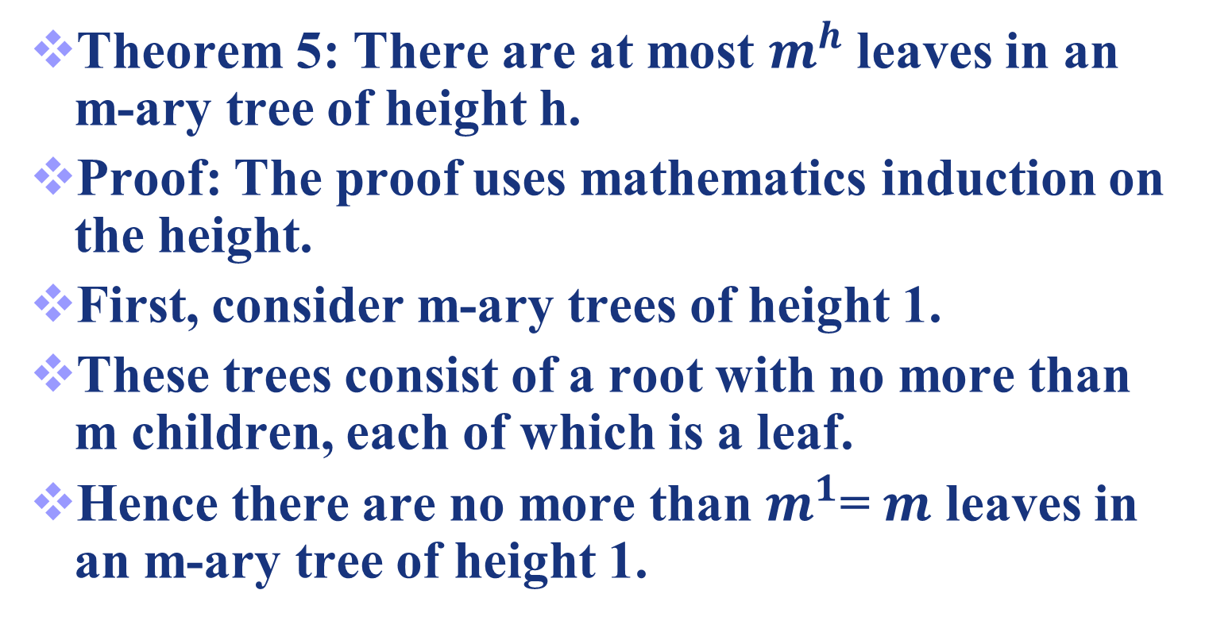

Slide 49
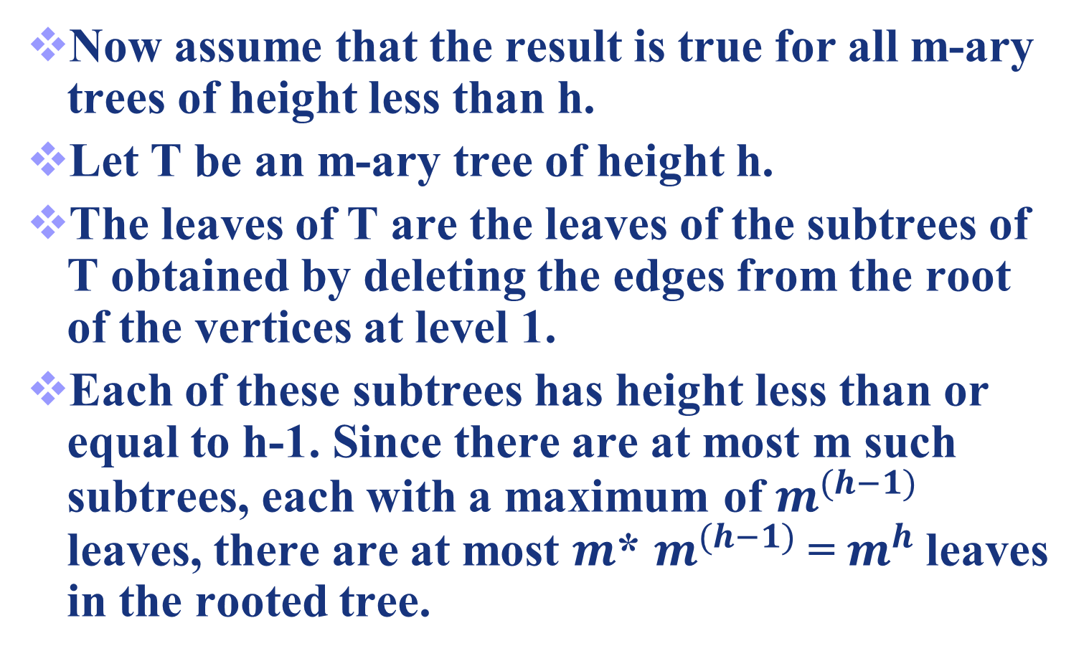
Proof of Theorem 5

Slide 50
Corollary 1: If an m-ary tree of height h has l leaves, then h ≥ . If the m-ary tree is full and balanced, then h = .
Proof: We know that from Theorem 5. Taking logarithms to the base m shows that
. Since h is an integer, we have .
Now suppose that the tree is balanced. Each leaf is at level h or h-1, and since the height is h, there is at least on leaf at level h.

Slide 51
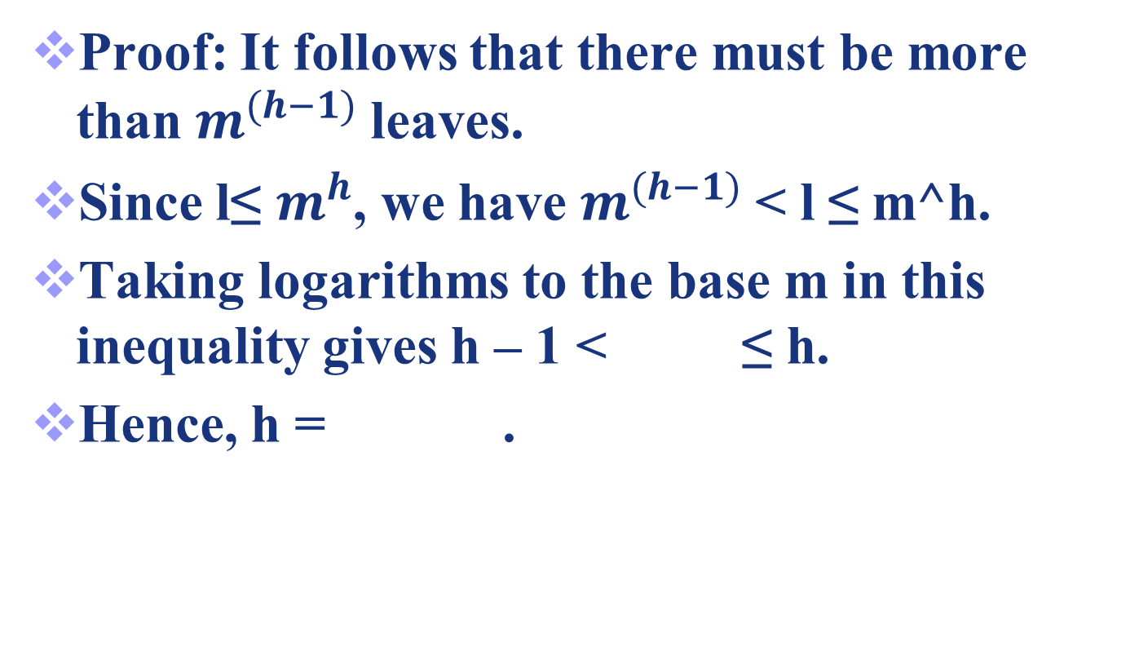

Slide 52
Applications
52

Slide 53

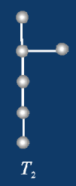
Applications
1.已知道无向树T中，有1个3度结点，2个2度结点，其余结点都是树叶，试求树叶数，并画出满足要求的非同构的无向树。
解：设有x片树叶，于是结点总数为
n=1+2+x=3+x
由握手定理和树的性质m=n-1可知，
2m=2(n-1)=2*(2+x)=1*3+2*2+x
得到x=3,因此T有3片树叶。
故T的度数应为1、1、1、2、2、3.

Slide 54
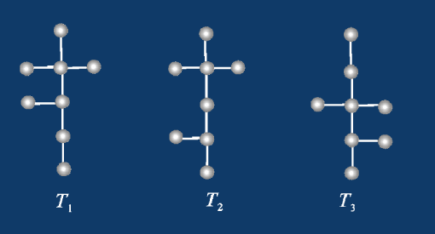
Applications
2. 已知道无向树T有5片树叶，2度与3度顶点各1个，其余顶点的度数均为4，求T所包含的结点数n，并画出满足要求的所有非同构的无向树。
解：T所包含的边数m=n-1,4度顶点的个数为n-7。
由握手定理得
2m=2(n-1)=5*1+2*1+3*1+4(n-7)
得n=8，因此4度结点的有1个。
故T的顶点度数为1、1、1、1、1、2、3、4。

Slide 55
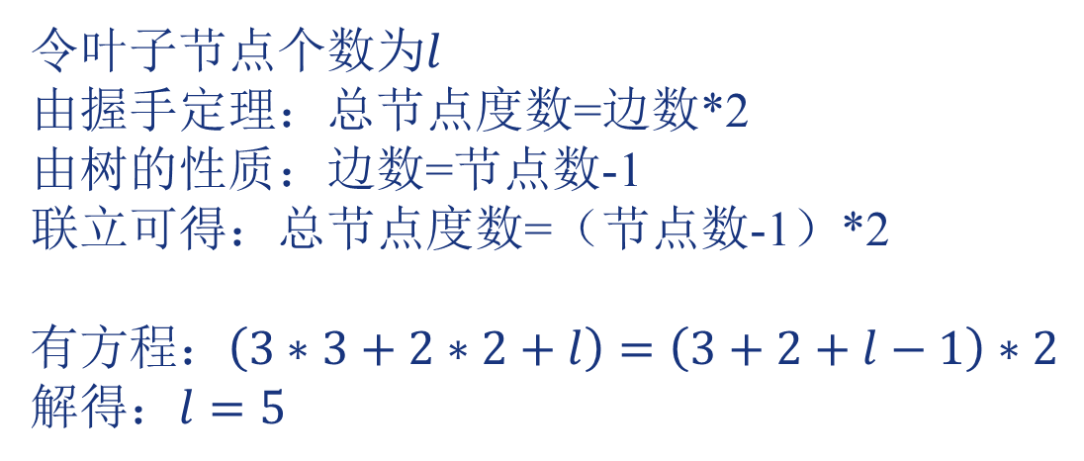
Exercises
1. A tree T has three 3-degree vertices, two 2-degree vertices, and all the other vertices are leaves. How many leaves are there in T? ( )
A) 1 B) 4 C) 5 D) 6
C
令叶子节点个数为$l$
由握手定理：总节点度数=边数*2
由树的性质：边数=节点数-1
联立可得：总节点度数=（节点数-1）*2
有方程：$\left(3∗3+2∗2+l\right)=\left(3+2+l−1\right)∗2$
解得：$l=5$
Notes:
好像涉及树

Slide 56
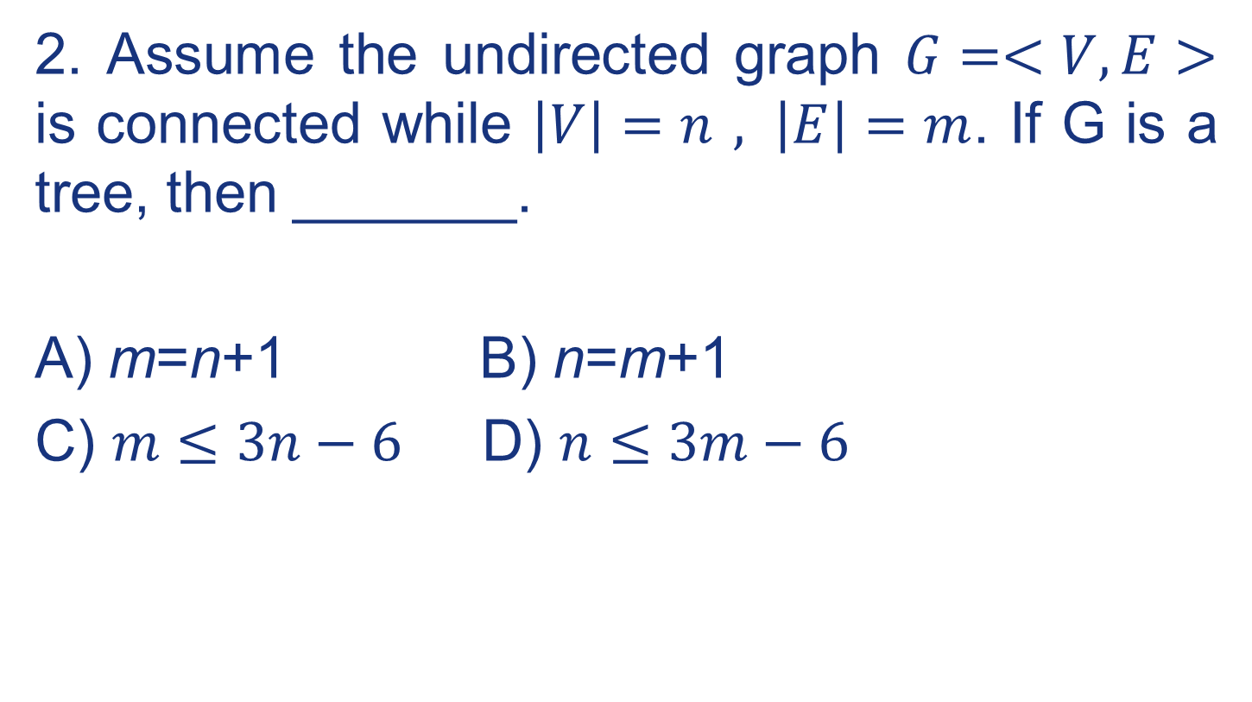
Exercises
2. Assume the undirected graph $G=<V,E>$ is connected while $\left|V\right|=n , \left|E\right|=m$. If G is a tree, then _______.
A) m=n+1 B) n=m+1
C) $m≤3n−6$ D) $n≤3m−6$
B
Notes:
好像涉及树

Slide 57




Exercises
3. Which of these graphs is tree? ( )
A
A
B
C
D
Notes:
好像涉及树

Slide 58
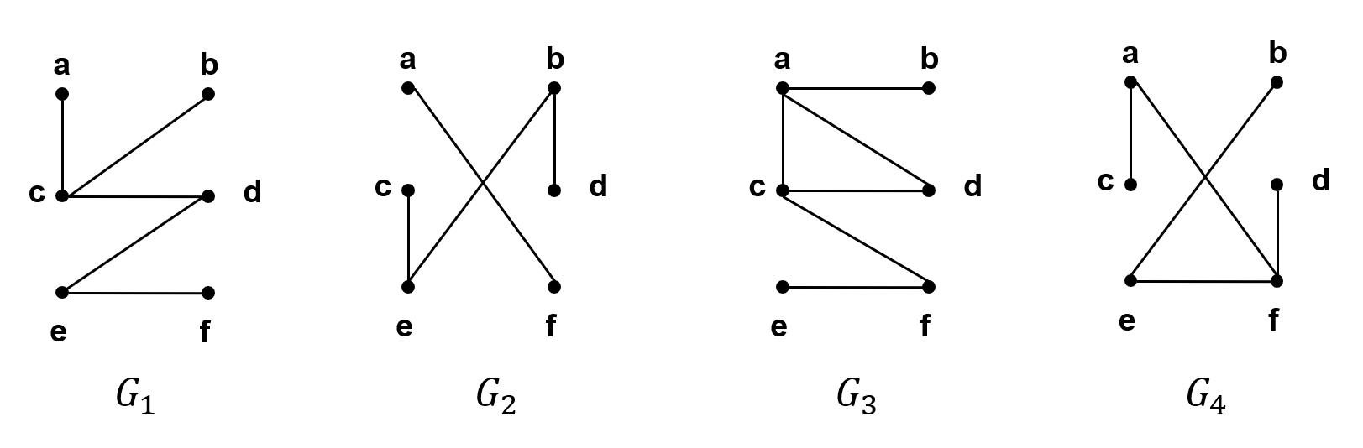
Exercises
4. Which of the graphs in Figure are trees?
C
Notes:
好像涉及树

Slide 59
Exercises
6. A full 3-ary tree has 27 edges. How many nodes with 4-degree does tree have? ( )
A) 8 B) 9
C) 0 D) 7
A
m=3
n = 27+1
n=m*i+1
i = 9
根节点度数为3，因此4度节点数=i-1=8
Notes:
好像涉及树

Slide 60
Exercises
7. The full 3-ary tree T contains 8 internal vertices, how many vertices and leaves does T has? ( )
A) 24 vertices and 15 leaves
B) 24 vertices and 17 leaves
C) 25 vertices and 15 leaves
D) 25 vertices and 17 leaves
D
m=3
i = 8
n=m*i+1=25
l=n-i=17
Notes:
好像涉及树

Slide 61
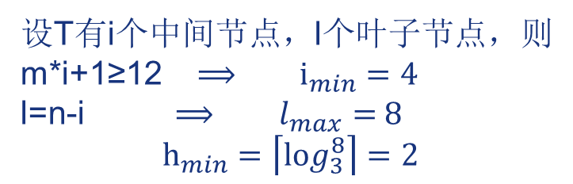
Exercises
8. For a 3-ary Tree T containing 12 vertices, what is the minimum height of T? ( )
A) 1
B) 2
C) 3
D) 4
B
设T有i个中间节点，l个叶子节点，则
m*i+1≥12 $⟹$ $i_{min}=4$
l=n-i $⟹$ $l_{max}=$ 8
$$h_{min}=\left\lceil \log_{3}^{8}\right\rceil =2$$
Notes:
好像涉及树

Slide 62
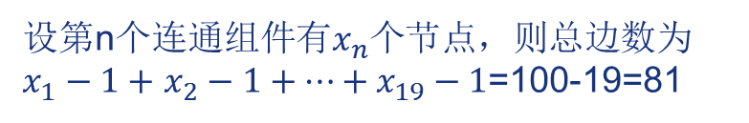
Exercises
9. G is a graph with 100 vertexes and 19 connected components, where each connected component is a tree. G has _____ edges. (How many?)
81
设第n个连通组件有$x_{n}$个节点，则总边数为$x_{1}−1+$ $x_{2}−1+…+x_{19}−1$=100-19=81
Notes:
好像涉及树

Slide 63
Exercises
10. A tree has 3 internal vertices of 4 degrees, 2 internal vertices of 3 degrees and x leaves. x= _____
10
3*4+2*3+x = (3+2+x-1)*2
x = 10
Notes:
好像涉及树

Slide 64
Exercises
11. How many nonisomorphic unrooted trees with three vertices are there? _____________________
1
Notes:
好像涉及树

Slide 65
Exercises
12. In a tree with 7 leaves, there are three 3- degree nodes, and the rest nodes are 4- degree nodes, then the tree has ________________(How many?) 4-degree nodes.
1
令4度节点有x个
3*3+4x+7 = (3+x+7-1)*2
解得：x = 1
Notes:
好像涉及树

Slide 66

Exercises
13. There are at most __________leaves in a 2-ary tree of height 6.
64
$$l≤m^{h}=2^{6}=64$$
Notes:
好像涉及树

Slide 67
Exercises
14. T is a full 3-ary tree of height 4. How many vertices are there in T at least?
13
最少有4个中间节点，n=m*i+1=3*4+1=13
Notes:
好像涉及树

Slide 68
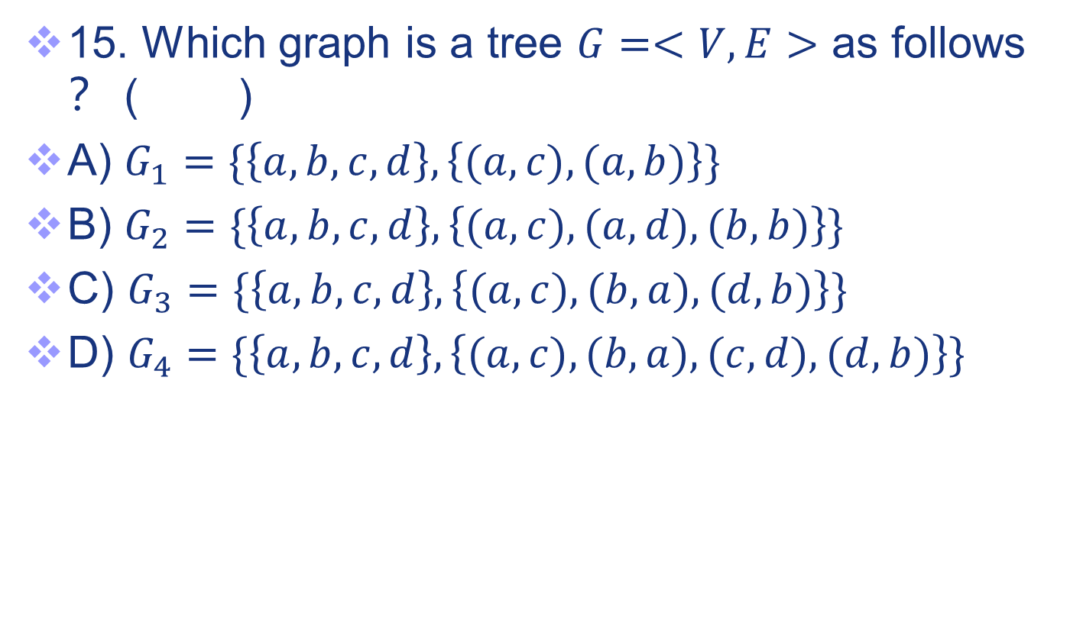
Exercises
15. Which graph is a tree $G=<V,E>$ as follows？ ( )
A) $G_{1}=\{\left\{a,b,c,d\right\},\left\{(a,c),(a,b)\right\}\}$
B) $G_{2}=\{\left\{a,b,c,d\right\},\left\{(a,c),(a,d),(b,b)\right\}\}$
C) $G_{3}=\{\left\{a,b,c,d\right\},\left\{(a,c),(b,a),(d,b)\right\}\}$
D) $G_{4}=\{\left\{a,b,c,d\right\},\left\{(a,c),(b,a),(c,d),(d,b)\right\}\}$
C
Notes:
好像涉及树

Slide 69
Exercises
16. The number of cut edges of a tree which has 18 nodes in total is ___
17
树的每一条边都是cut edge。18-1=17
Notes:
好像涉及树

Slide 70
Exercises
17. A tree T has 5 nodes with 2 degrees, 3 nodes with 3 degrees, 4 nodes with 4 degrees, 2 nodes with 5 degrees, and the rest are nodes with 1 degree. How many nodes with 1 degree does T have? (Write down the number of node.)
设1度的节点有x个，则5*2+3*3+4*4+2*5+x=(5+3+4+2+x-1)*2
解得x=19
Notes:
好像涉及树

Slide 71
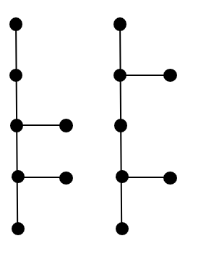
Exercises
18. You are asked by the School of Chemistry and Chemical Engineering to help them generate the structure of a molecular formula (分子式) which is known as a tree that has one 2-degree node, two 3-degree nodes, and several leaves. Please try to draw all non-isomorphic structures that meet the requirements.
设叶子节点有x个，则1*2+2*3+x=(1+2+x-1)*2
解得x=4
4个叶节点
Notes:
好像涉及树

Slide 72
Exercises
19. Suppose that someone starts chain postcard. Each person who receives the postcard is asked to send it on to three other people. Some people do this, but others do not send any postcards. How many people have seen the postcard, including the first person, if no one receives more than one postcard and if the chain postcard ends after there have been 17 people who read it but did not send it out ? How many people sent out the postcard?
Solution: The chain postcard can be represented using 3-ary tree.
The internal vertices correspond to people who sent out the postcard, and the leaves correspond to people who did not send it out.
Since 17 people did not send out the postcard, the number of leaves in this rooted tree is l = 17.
Hence, part (iii) of Theorem 4 shows that the number of people who have seen the postcard, including the first person, is n=(3*17-1)/(3-1)=25.
The number of internal vertices is 25 – 17 =8, so that 8 people sent out the postcard.
Notes:
好像涉及树

Slide 73
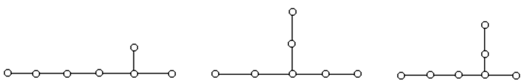
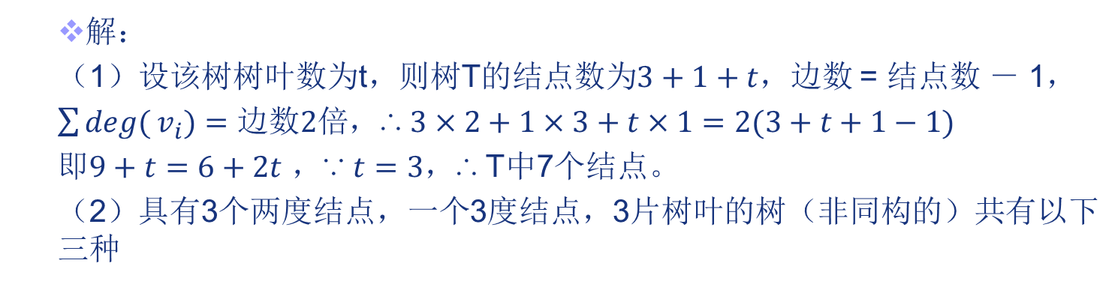
Exercises
20. Tree T has 3 vertices of 2-degree, 1 vertex of 3-degree, and the other vertices are all leaves.
How many vertices does T have?
Construct all the possible non-homeomorphic trees of T.
解：
（1）设该树树叶数为t，则树T的结点数为$3+1+t$，边数 = 结点数 － 1，
$\sum{\deg{(}v_{i})=边数2倍}$，∴ $3×2+1×3+t×1=2(3+t+1−1)$
即$9+t=6+2t$ ，∵ $t=3$，∴ T中7个结点。
（2）具有3个两度结点，一个3度结点，3片树叶的树（非同构的）共有以下三种
Notes:
好像涉及树

Slide 74
Exercises
21. Let T be a tree where all interval vertices are either 3-degree or 4-degree. Given that T has 9 leaves and 13 edges, how many 3-degree vertices and 4-degree vertices are there in T?
Notes:
好像涉及树

Slide 75
Exercises
22. An undirected tree has five leaves, one 2-degree vertex, one 3-degree vertex and the degree of the rest vertexes is all 4. How many vertexes dose the tree has in total? Please draw all of the undirected trees which are non-isomorphism to each other.
设4度的节点有x个，则
5+1*2+1*3+4x=(5+1+1+x-1)*2
解得x=1
所以共有5+1+1+1=8 vertices
Notes:
好像涉及树

Slide 76
End of Section 5.1
Click to edit company slogan .
76

